Slide 1


Gaussian Mixtures
Machine Learning – Spring 2018
Paul Gader

Slide 2
Mixture Models
where

Slide 3

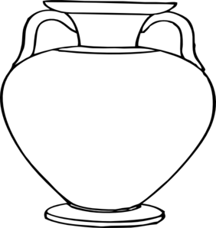
Conceptual Sampling Model
Repeat many times:
Someone behind curtain takes a ball from an urn and throws it out in front of the curtain
How many urns are there?
What is the probability of selecting from an urn?
What is the percentage of each color in each urn?
Samples

Slide 4
Probability Model
Assume we know of number of components (urns), K
Sampling Model: Input is K
For n = 1 to N
Select a component kn
Select a sample from the PDF of the component, xn
End For
Output is X = { (x1,k1), (x2, k2), …, (xN, kN)} where
xn are observed input data
kn are unobserved input data
Expectation Maximization
Maximize the expected value of the Likelihood over unobserved data

Slide 5
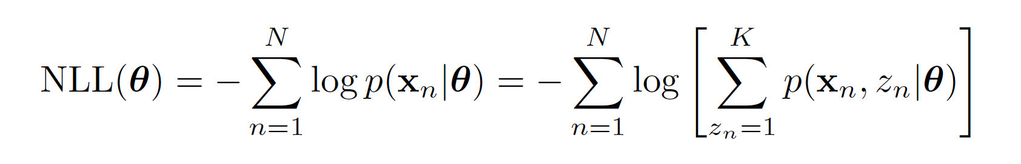
Expectation Maximization (EM) Algorithm for Gaussian Mixtures

Slide 6
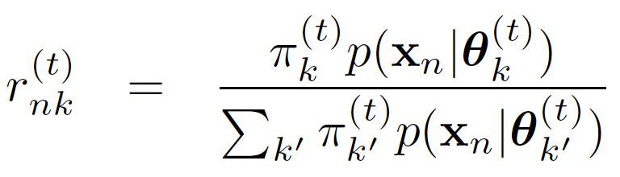
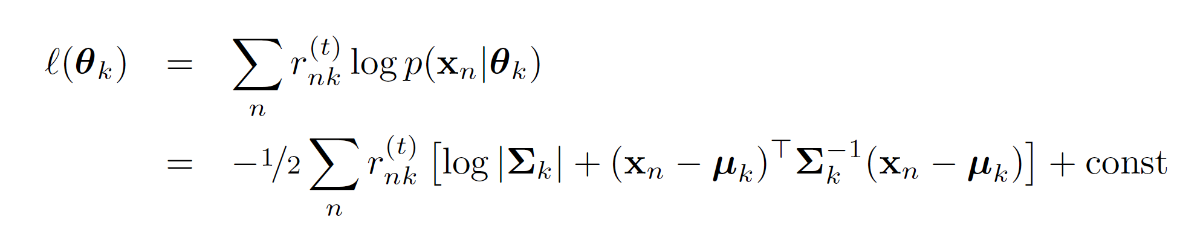
EM
E-Step
M-Step

Slide 7
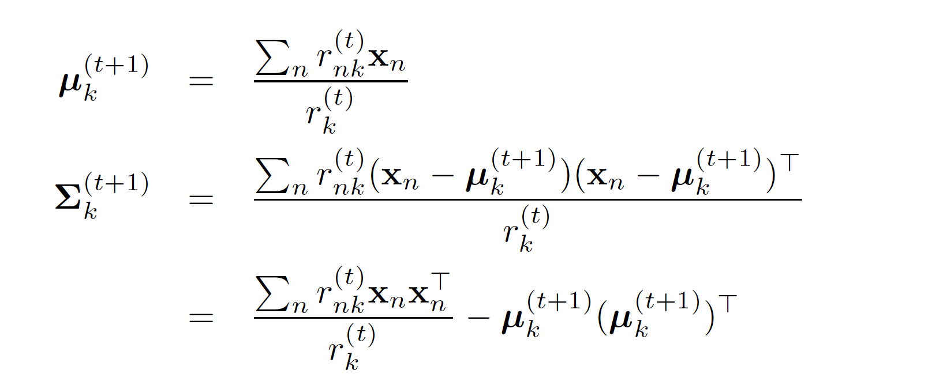
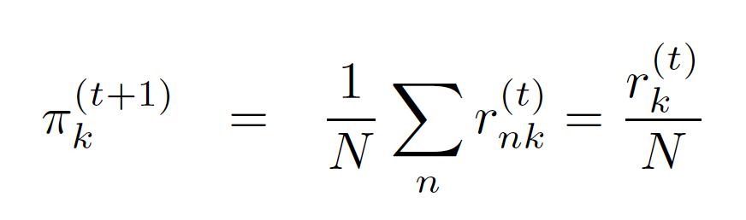

Slide 8
Go To MATLAB

